Slide 1
Generating Functions, Inclusion & Exclusion Principles, Mathematical Induction
by
Dr. T. M. Rajalaxmi
Assistant Professor
Department of Mathematics

Slide 2
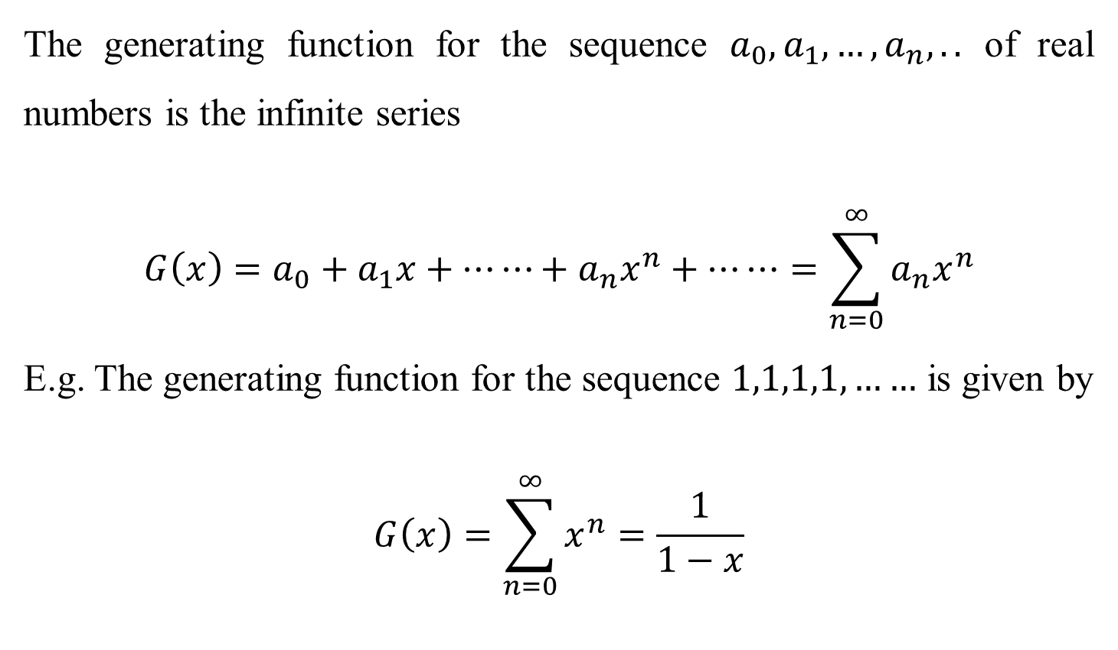
Definition
The generating function for the sequence $a_{0},a_{1},…,a_{n},..$ of real numbers is the infinite series
$$G\left(x\right)=a_{0}+a_{1}x+⋯⋯+a_{n}x^{n}+⋯⋯=\sum_{n=0}^{∞}{a_{n}x^{n}}$$
E.g. The generating function for the sequence $1,1,1,1,……$ is given by
$$G\left(x\right)=\sum_{n=0}^{∞}{x^{n}}=\frac{1}{1−x}$$

Slide 3

Problem
Using generating function, solve the recurrence relation $y_{n+2}−y_{n+1}−6y_{n}=0, y_{1}=1,y_{0}=2.$

Slide 4

Problem
Using generating function, solve the recurrence relation $y_{n+2}−y_{n+1}−6y_{n}=0, y_{1}=1,y_{0}=2.$
Solution: Let $G\left(x\right)$ be the generating function for the sequence $\left\{y_{n}\right\}, n≥0.$

Slide 5
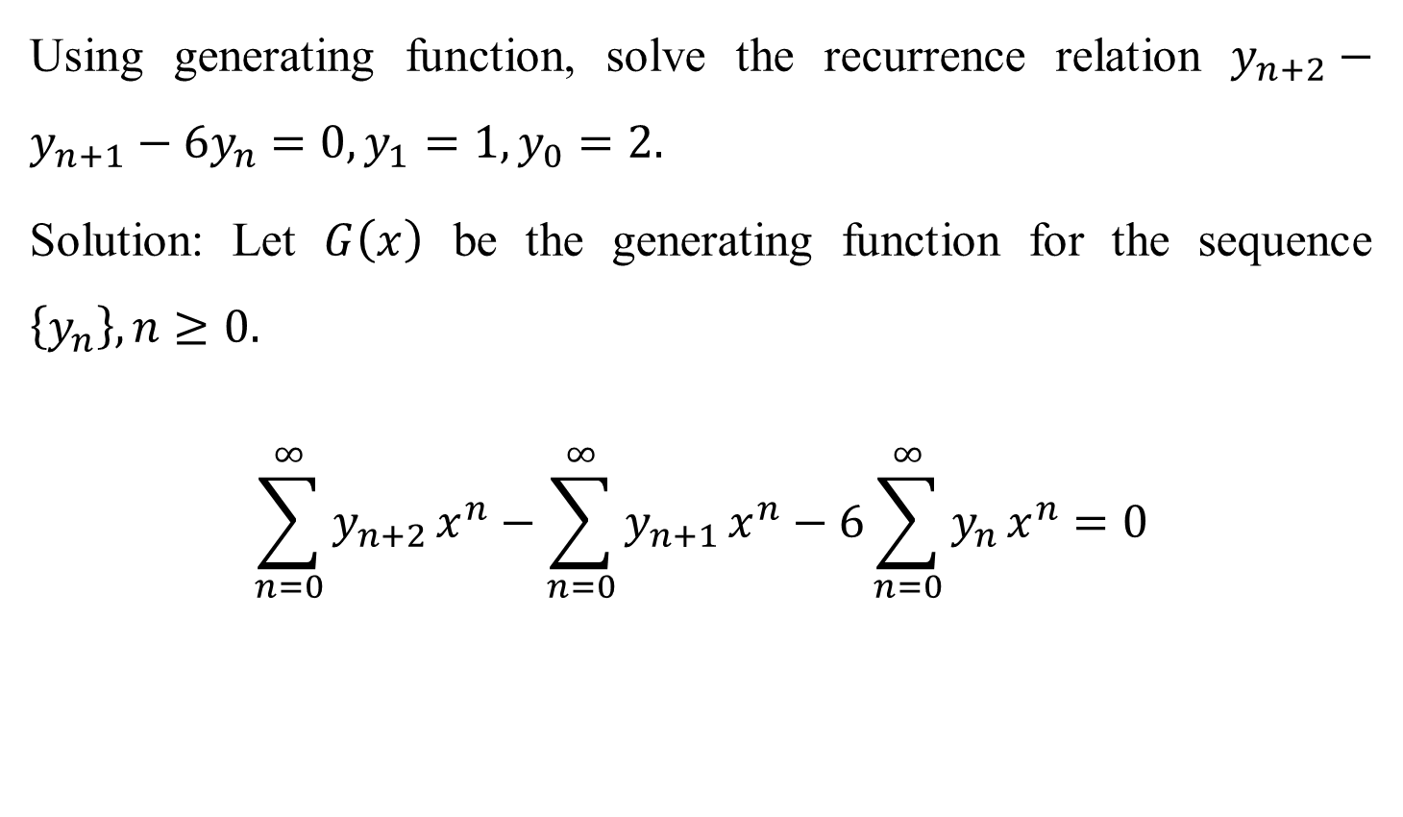
Problem
Using generating function, solve the recurrence relation $y_{n+2}−y_{n+1}−6y_{n}=0, y_{1}=1,y_{0}=2.$
Solution: Let $G\left(x\right)$ be the generating function for the sequence $\left\{y_{n}\right\}, n≥0.$
$$\sum_{n=0}^{∞}{y_{n+2 }x^{n}}−\sum_{n=0}^{∞}{y_{n+1 }x^{n}}−6\sum_{n=0}^{∞}{y_{n }x^{n}}=0$$

Slide 6

Problem
$$\sum_{n=0}^{∞}{y_{n+2 }x^{n}}−\sum_{n=0}^{∞}{y_{n+1 }x^{n}}−6\sum_{n=0}^{∞}{y_{n }x^{n}}=0$$
$$\frac{1}{x^{2}}\sum_{n=0}^{∞}{y_{n+2 }x^{n+2 }}−\frac{1}{x}\sum_{n=0}^{∞}{y_{n+1 }x^{n+1}}−6\sum_{n=0}^{∞}{y_{n }x^{n}}=0$$

Slide 7

Problem
$$\frac{1}{x^{2}}\sum_{n=0}^{∞}{y_{n+2 }x^{n+2 }}−\frac{1}{x}\sum_{n=0}^{∞}{y_{n+1 }x^{n+1}}−6\sum_{n=0}^{∞}{y_{n }x^{n}}=0$$
$$\frac{1}{x^{2}}\left(y_{2}x^{2}+y_{3}x^{3}+⋯\right)−\frac{1}{x}\left(y_{1}x+y_{2}x^{2}+⋯\right)−6\left(y_{0}+y_{1}x+y_{2}x^{2}+⋯\right)=0$$
$$\frac{1}{x^{2}}\left(y_{0}+y_{1}x+y_{2}x^{2}+y_{3}x^{3}+⋯−y_{0}−y_{1}x\right)−\frac{1}{x}\left(y_{0}+y_{1}x+y_{2}x^{2}+⋯−y_{0}\right)−6G\left(x\right)=0$$
$$\frac{1}{x^{2}}\left(G(x)−2−x\right)−\frac{1}{x}\left(G(x)−2\right)−6G\left(x\right)=0$$

Slide 8
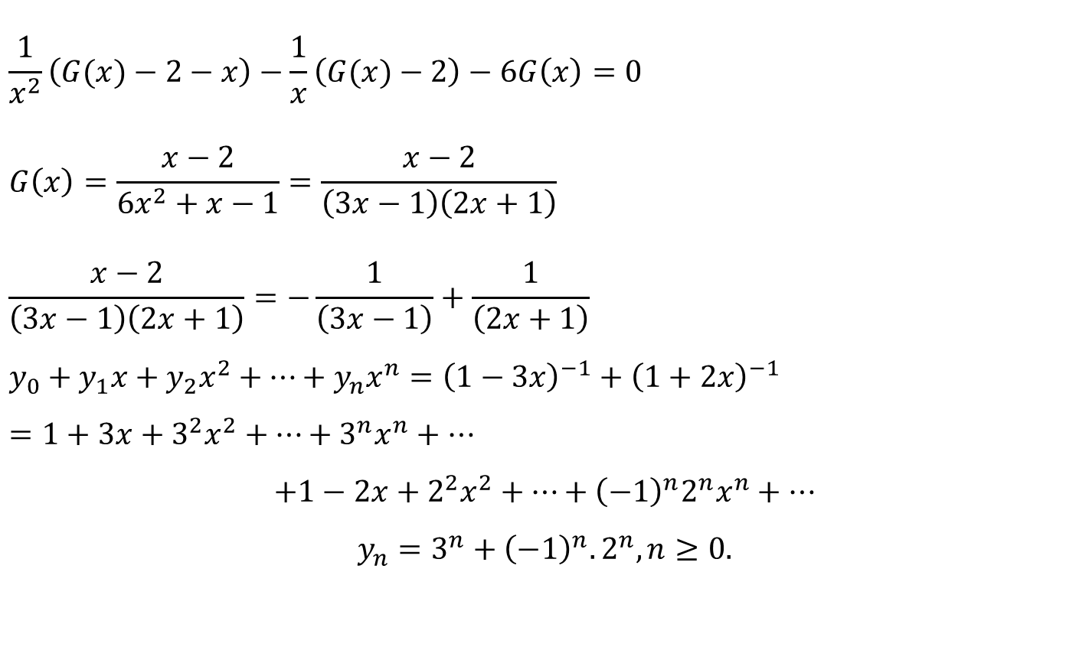
Problem
$$\frac{1}{x^{2}}\left(G(x)−2−x\right)−\frac{1}{x}\left(G(x)−2\right)−6G\left(x\right)=0$$
$$G\left(x\right)=\frac{x−2}{6x^{2}+x−1}=\frac{x−2}{\left(3x−1\right)\left(2x+1\right)}$$
$$\frac{x−2}{\left(3x−1\right)\left(2x+1\right)}=−\frac{1}{\left(3x−1\right)}+\frac{1}{\left(2x+1\right)}$$
$$y_{0}+y_{1}x+y_{2}x^{2}+…+y_{n}x^{n}={\left(1−3x\right)}^{−1}+{\left(1+2x\right)}^{−1}$$
$$=1+3x+3^{2}x^{2}+…+3^{n}x^{n}+…$$
$$+1−2x+2^{2}x^{2}+…+{\left(−1\right)}^{n}2^{n}x^{n}+…$$
$$y_{n}=3^{n}+{\left(−1\right)}^{n}.2^{n}, n≥0.$$

Slide 9

Inclusion and exclusion principle
If $A, B, C$ are not mutually exclusive, then
$$\left|A∪B\right|=|A|+|B|−|A∩B|$$
$$\left|A∪B∪C\right|=\left|A\right|+\left|B\right|+\left|C\right|−\left|A∩B\right|−|B∩C|−|C∩A|+|A∩B∩C|$$

Slide 10
Inclusion and exclusion principle
Problem: A survey of 100 students with respect to their choice of the ice cream flavors vanilla, Chocolate and Strawberry shows that 50 students like vanilla, 43 like chocolate, 28 like strawberry, 13 like vanilla and chocolate, 11 like chocolate and strawberry, 12 like strawberry and vanilla, and 5 like all of them. Find the number of students who like (i) vanilla only (ii) chocolate only (iii) strawberry only (iv) chocolate but not strawberry (v) chocolate and strawberry but not vanilla (vi) vanilla or chocolate but not strawberry.
Also find the number of students who do not like any of these flavors.

Slide 11

Inclusion and exclusion principle
Solution: We shall display the data in Venn diagram and compute.
Let $S, V, C$ denote the set of students like Strawberry, Vanilla, and Chocolate flavored ice creams respectively.

Slide 12
Inclusion and exclusion principle
C
V
S

Slide 13
Inclusion and exclusion principle
C
V
5
S

Slide 14
Inclusion and exclusion principle
C
V
8
5
S

Slide 15
Inclusion and exclusion principle
C
V
8
5
6
S

Slide 16
Inclusion and exclusion principle
C
V
8
5
6
7
S

Slide 17
Inclusion and exclusion principle
C
V
8
30
5
6
7
S

Slide 18
Inclusion and exclusion principle
C
V
24
8
30
5
6
7
S

Slide 19
Inclusion and exclusion principle
C
V
24
8
30
5
6
7
10
S

Slide 20
Inclusion and exclusion principle
C
V
24
8
30
5
6
7
10
S
From the Venn diagram
Number of students who like vanilla only = 30
Number of students who like chocolate only = 24
Number of students who like strawberry only = 10

Slide 21
Inclusion and exclusion principle
C
V
24
8
30
5
6
7
10
S
From the Venn diagram
(iv) Number of students who like chocolate but not strawberry 24+8=32
(v) Number of students who like chocolate and strawberry but not vanilla =6

Slide 22
Inclusion and exclusion principle
C
V
24
8
30
5
6
7
10
S
From the Venn diagram
(vi) Number of students who like vanilla or chocolate but not strawberry
= 24+8+30=62
(vii) Number of students who do not like any of these flavors
=100 – 90=10

Slide 23
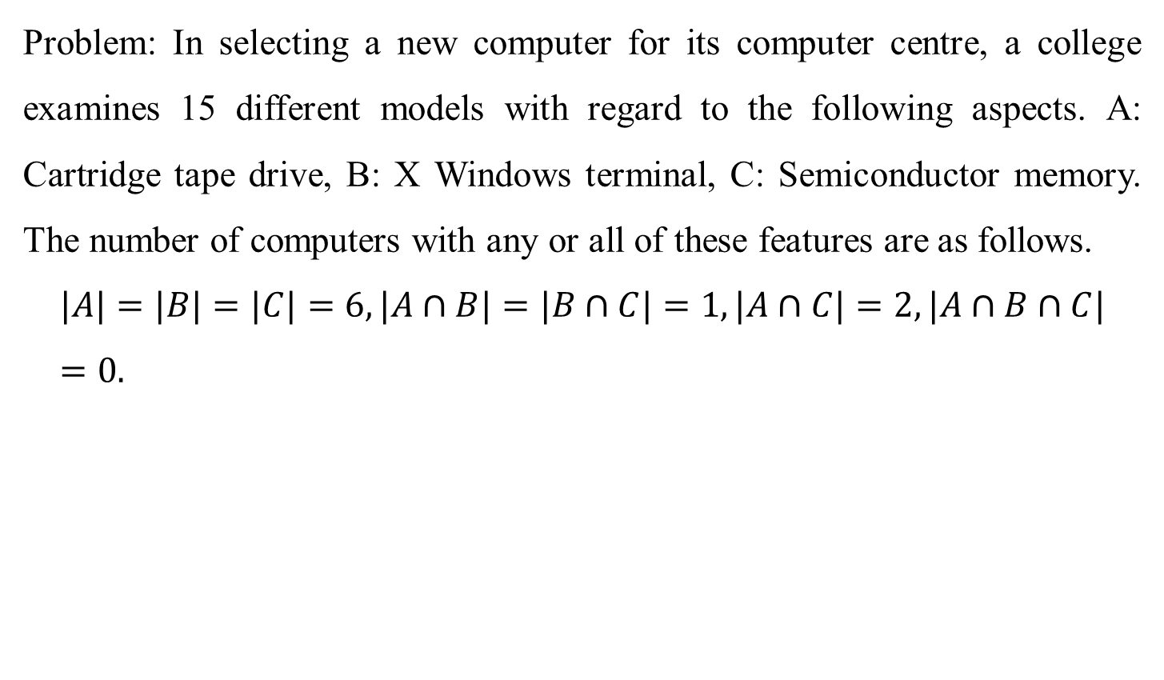
Inclusion and exclusion principle
Problem: In selecting a new computer for its computer centre, a college examines 15 different models with regard to the following aspects. A: Cartridge tape drive, B: X Windows terminal, C: Semiconductor memory. The number of computers with any or all of these features are as follows.
$$|A|=|B|=|C|=6, |A∩B|=|B∩C|=1, |A∩C|=2, |A∩B∩C|=0.$$

Slide 24
Inclusion and exclusion principle

Slide 25
Inclusion and exclusion principle
A
B
C

Slide 26
Inclusion and exclusion principle
A
B
2
C

Slide 27
Inclusion and exclusion principle
A
B
2
1
C

Slide 28
Inclusion and exclusion principle
A
B
1
2
1
C

Slide 29
Inclusion and exclusion principle
A
B
3
1
4
2
1
3
C

Slide 30
Inclusion and exclusion principle
A
B
(i) Number of models with exactly one feature
= 3 + 3 + 4 = 10
(ii) Number of models with none of the feature
= 15 – 14 = 1
(iii) Number of models with exactly two of the
features = 2 + 1 + 1 = 4
3
1
4
2
1
3
C

Slide 31
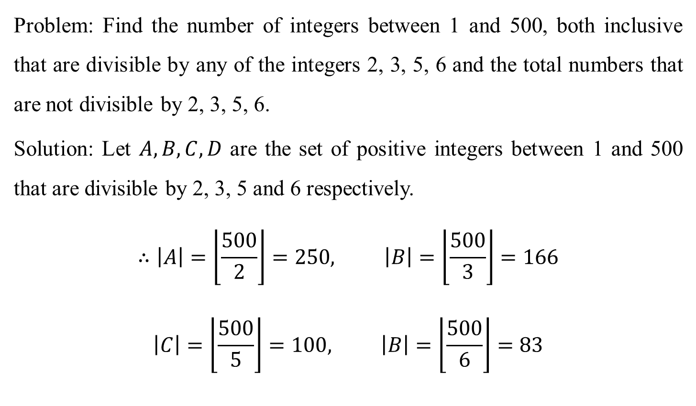
Inclusion and exclusion principle
Problem: Find the number of integers between 1 and 500, both inclusive that are divisible by any of the integers 2, 3, 5, 6 and the total numbers that are not divisible by 2, 3, 5, 6.
Solution: Let $A, B, C,D$ are the set of positive integers between 1 and 500 that are divisible by 2, 3, 5 and 6 respectively.
$$∴\left|A\right|=\left\lfloor \frac{500}{2}\right\rfloor =250, \left|B\right|=\left\lfloor \frac{500}{3}\right\rfloor =166$$
$$\left|C\right|=\left\lfloor \frac{500}{5}\right\rfloor =100, \left|B\right|=\left\lfloor \frac{500}{6}\right\rfloor =83$$

Slide 32

Inclusion and exclusion principle
$$\left|A∩B\right|=\left\lfloor \frac{500}{LCM (2,3)}\right\rfloor =\left\lfloor \frac{500}{2 x 3}\right\rfloor =83$$
$$\left|A∩C\right|=\left\lfloor \frac{500}{LCM (2,5)}\right\rfloor =\left\lfloor \frac{500}{2 x 5}\right\rfloor =50$$
$$\left|A∩D\right|=\left\lfloor \frac{500}{LCM (2,6)}\right\rfloor =\left\lfloor \frac{500}{ 6}\right\rfloor =83$$

Slide 33

Inclusion and exclusion principle
$$\left|B∩C\right|=\left\lfloor \frac{500}{LCM (3,5)}\right\rfloor =\left\lfloor \frac{500}{3 x 5}\right\rfloor =33$$
$$\left|B∩D\right|=\left\lfloor \frac{500}{LCM (3,6)}\right\rfloor =\left\lfloor \frac{500}{6}\right\rfloor =83$$
$$\left|C∩D\right|=\left\lfloor \frac{500}{LCM (5,6)}\right\rfloor =\left\lfloor \frac{500}{5 x 6}\right\rfloor =16$$

Slide 34
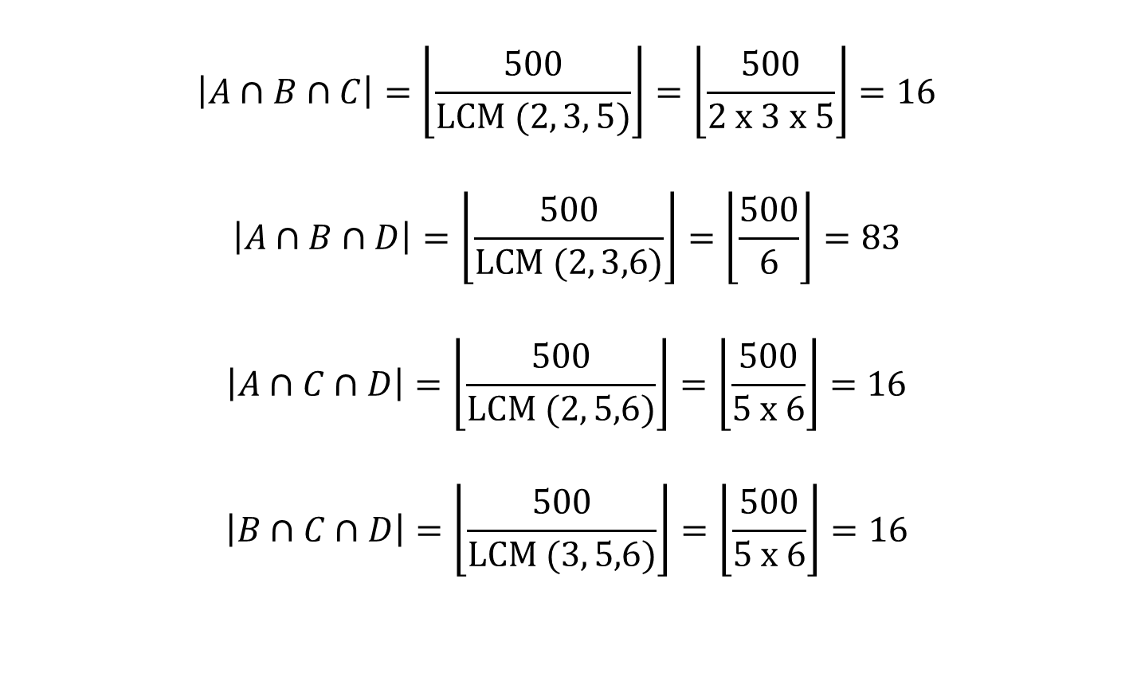
Inclusion and exclusion principle
$$\left|A∩B∩C\right|=\left\lfloor \frac{500}{LCM (2, 3, 5)}\right\rfloor =\left\lfloor \frac{500}{2 x 3 x 5}\right\rfloor =16$$
$$\left|A∩B∩D\right|=\left\lfloor \frac{500}{LCM (2, 3,6)}\right\rfloor =\left\lfloor \frac{500}{6}\right\rfloor =83$$
$$\left|A∩C∩D\right|=\left\lfloor \frac{500}{LCM (2, 5,6)}\right\rfloor =\left\lfloor \frac{500}{5 x 6}\right\rfloor =16$$
$$\left|B∩C∩D\right|=\left\lfloor \frac{500}{LCM (3, 5,6)}\right\rfloor =\left\lfloor \frac{500}{5 x 6}\right\rfloor =16$$

Slide 35
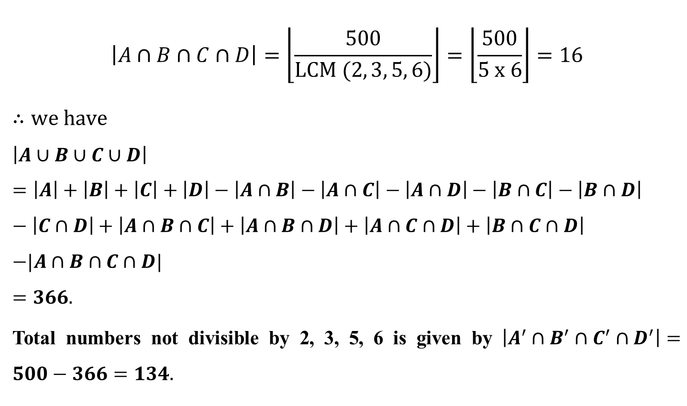
Inclusion and exclusion principle
$$\left|A∩B∩C∩D\right|=\left\lfloor \frac{500}{LCM (2, 3, 5, 6)}\right\rfloor =\left\lfloor \frac{500}{5 x 6}\right\rfloor =16$$
$∴we have$
$$\left|A∪B∪C∪D\right|=\left|A\right|+\left|B\right|+\left|C\right|+\left|D\right|−\left|A∩B\right|−\left|A∩C\right|−\left|A∩D\right|−\left|B∩C\right|−\left|B∩D\right|−\left|C∩D\right|+\left|A∩B∩C\right|+\left|A∩B∩D\right|+\left|A∩C∩D\right|+\left|B∩C∩D\right|$$
$$−|A∩B∩C∩D|$$
$$=366.$$
Total numbers not divisible by 2, 3, 5, 6 is given by $\left|A^{′}∩B^{′}∩C^{′}∩D^{′}\right|=500−366=134.$

Slide 36
Inclusion and exclusion principle
Problem for practice:
Find the number of integers between 1 and 250, both inclusive that are (i) divisible by 2, 3 (ii) divisible by 2, 3, 5 (iii) not divisible by 2, 3, 5.
Find the number of integers between 1 and 250, both inclusive that are divisible by 2, 3, 5, 7.

Slide 37
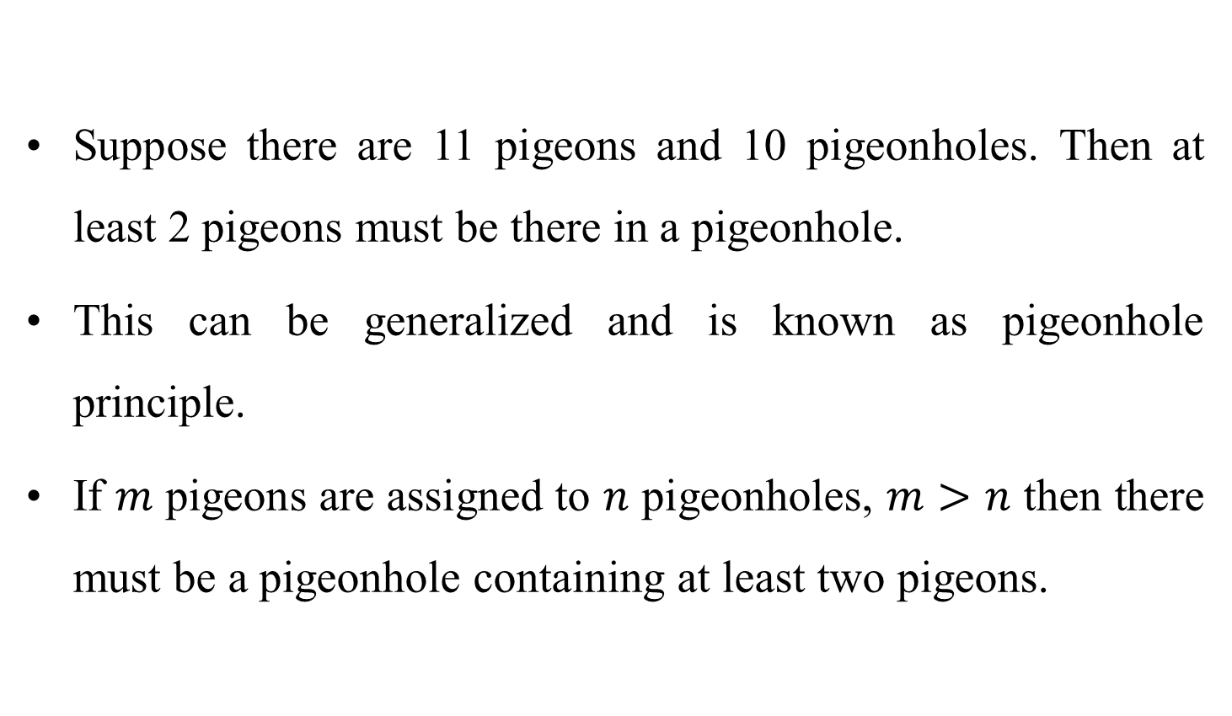
Pigeonhole Principle
Suppose there are 11 pigeons and 10 pigeonholes. Then at least 2 pigeons must be there in a pigeonhole.
This can be generalized and is known as pigeonhole principle.
If $m$ pigeons are assigned to $n$ pigeonholes, $m>n$ then there must be a pigeonhole containing at least two pigeons.

Slide 38
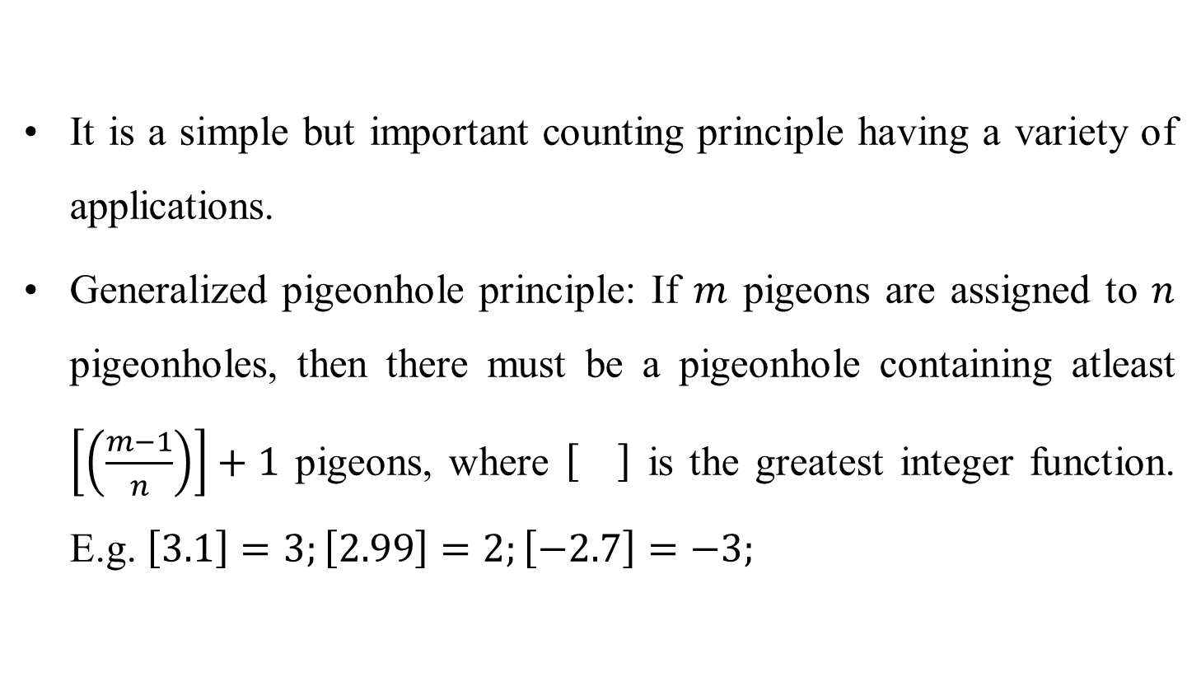
Pigeonhole Principle
It is a simple but important counting principle having a variety of applications.
Generalized pigeonhole principle: If $m$ pigeons are assigned to $n$ pigeonholes, then there must be a pigeonhole containing atleast $\left[\left(\frac{m−1}{n}\right)\right]+1$ pigeons, where is the greatest integer function. E.g. $\left[3.1\right]=3;\left[2.99\right]=2;\left[−2.7\right]=−3;$

Slide 39
Pigeonhole Principle
Problems
From a college if we select 367 students, then show that at least two of them will have the same birthday.
Solution:
There are 367 students and the maximum number of days in a year is 366 (leap year) and so 366 possible birthdays are there.
Treating the 367 as pigeons and the 366 birthdays as pigeonholes, by principle at least two students will have the same birthday.

Slide 40
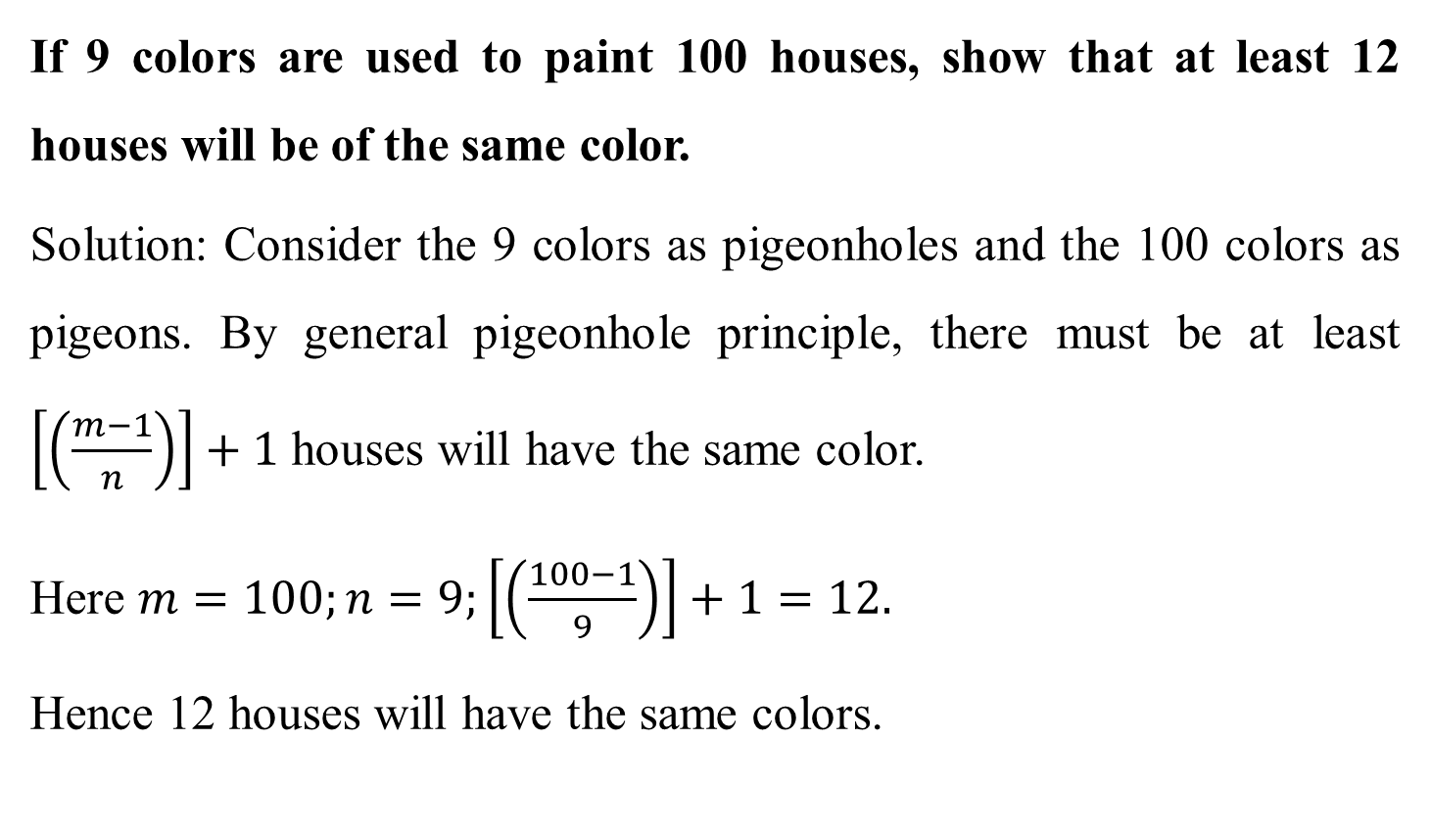
Pigeonhole Principle
If 9 colors are used to paint 100 houses, show that at least 12 houses will be of the same color.
Solution: Consider the 9 colors as pigeonholes and the 100 colors as pigeons. By general pigeonhole principle, there must be at least $\left[\left(\frac{m−1}{n}\right)\right]+1$ houses will have the same color.
Here $m=100;n=9;\left[\left(\frac{100−1}{9}\right)\right]+1=12.$
Hence 12 houses will have the same colors.

Slide 41
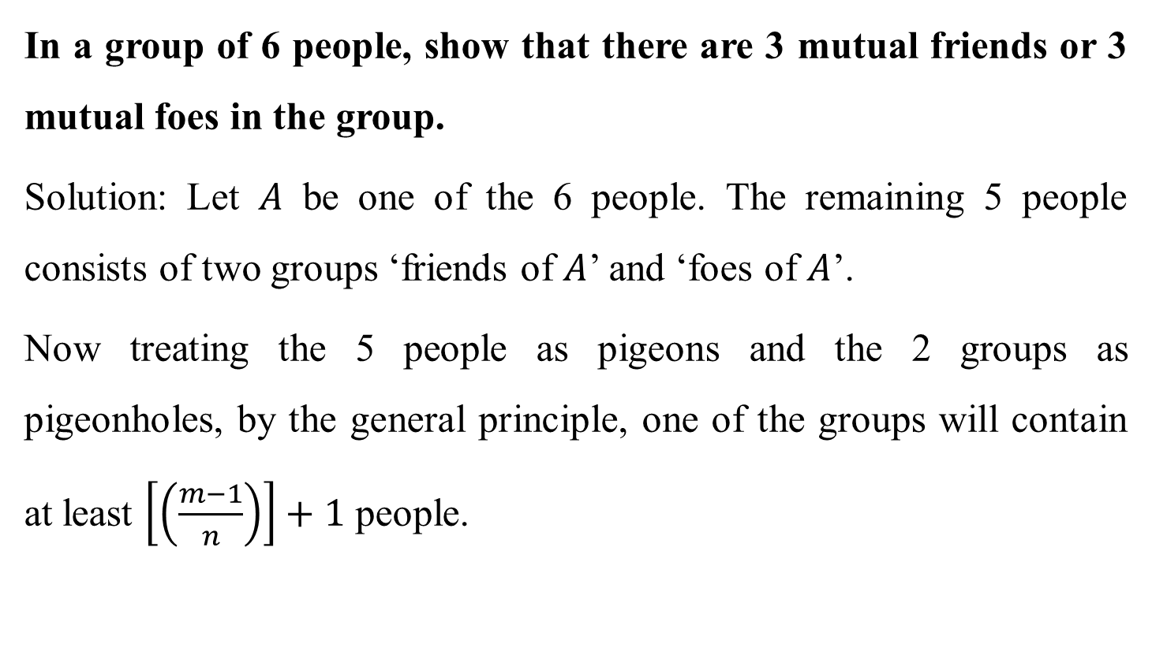
Pigeonhole Principle
In a group of 6 people, show that there are 3 mutual friends or 3 mutual foes in the group.
Solution: Let $A$ be one of the 6 people. The remaining 5 people consists of two groups ‘friends of $A$’ and ‘foes of $A$’.
Now treating the 5 people as pigeons and the 2 groups as pigeonholes, by the general principle, one of the groups will contain at least $\left[\left(\frac{m−1}{n}\right)\right]+1$ people.

Slide 42
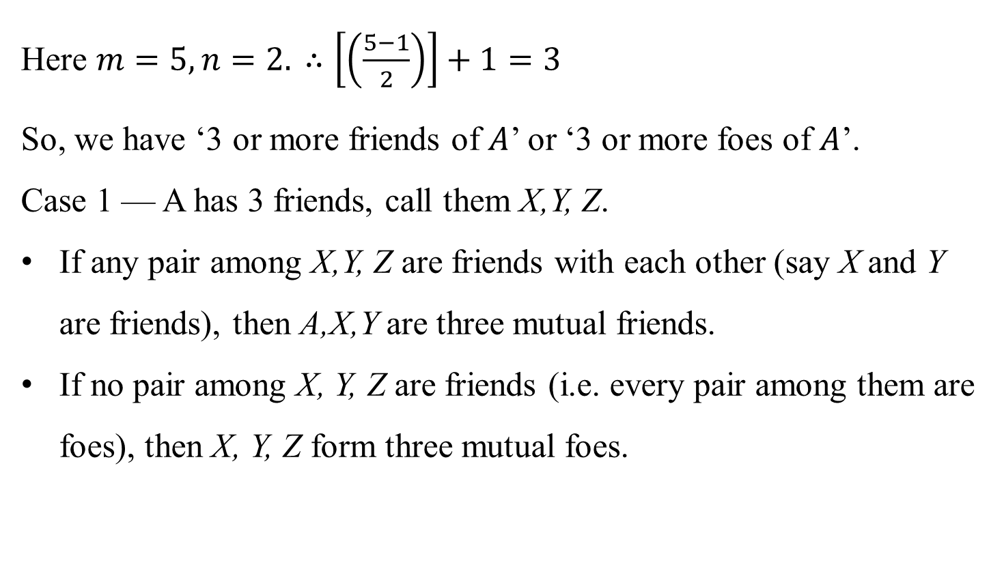
Pigeonhole Principle
Here $m=5, n=2. ∴\left[\left(\frac{5−1}{2}\right)\right]+1=3$
So, we have ‘3 or more friends of $A$’ or ‘3 or more foes of $A$’.
Case 1 — A has 3 friends, call them X,Y, Z.
If any pair among X,Y, Z are friends with each other (say X and Y are friends), then A,X,Y are three mutual friends.
If no pair among X, Y, Z are friends (i.e. every pair among them are foes), then X, Y, Z form three mutual foes.

Slide 43
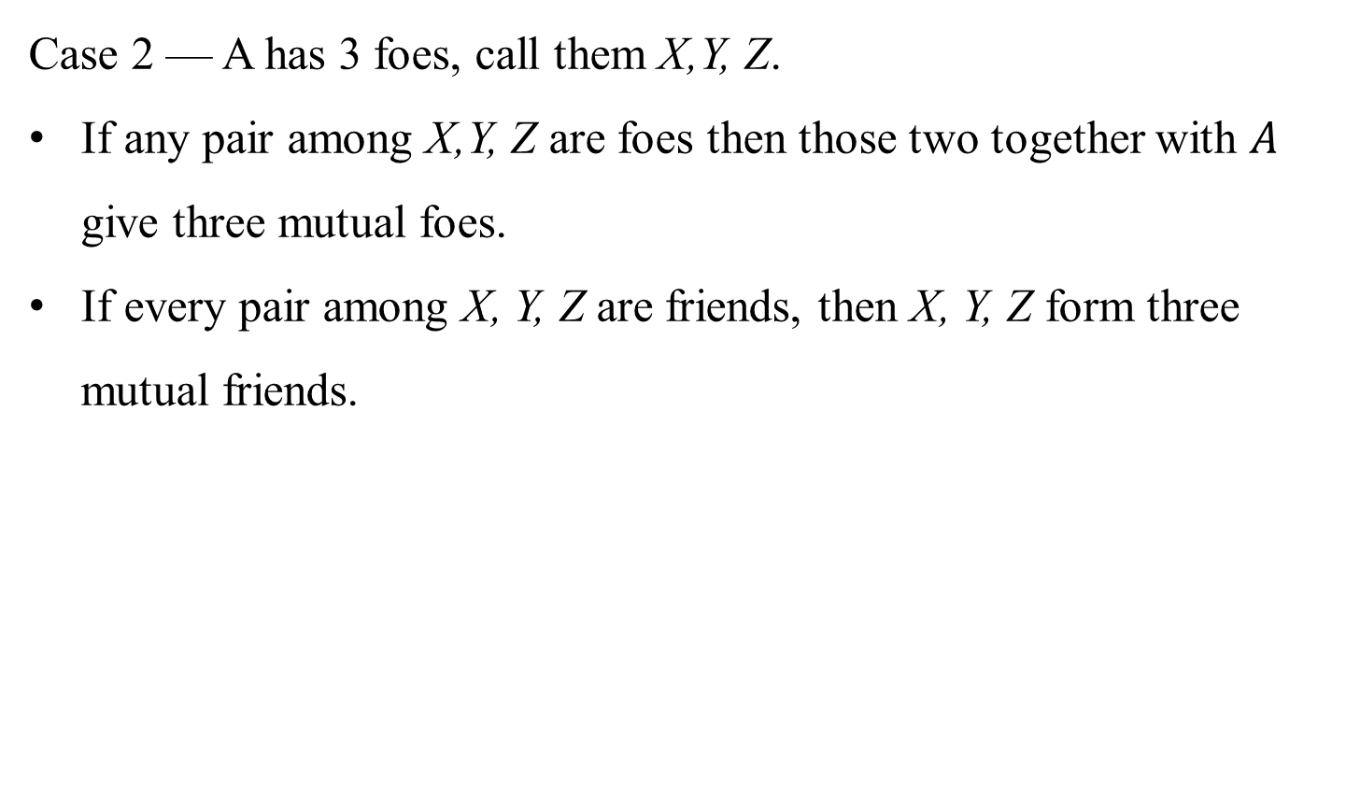
Pigeonhole Principle
Case 2 — A has 3 foes, call them X,Y, Z.
If any pair among X,Y, Z are foes then those two together with $A$ give three mutual foes.
If every pair among X, Y, Z are friends, then X, Y, Z form three mutual friends.

Slide 44
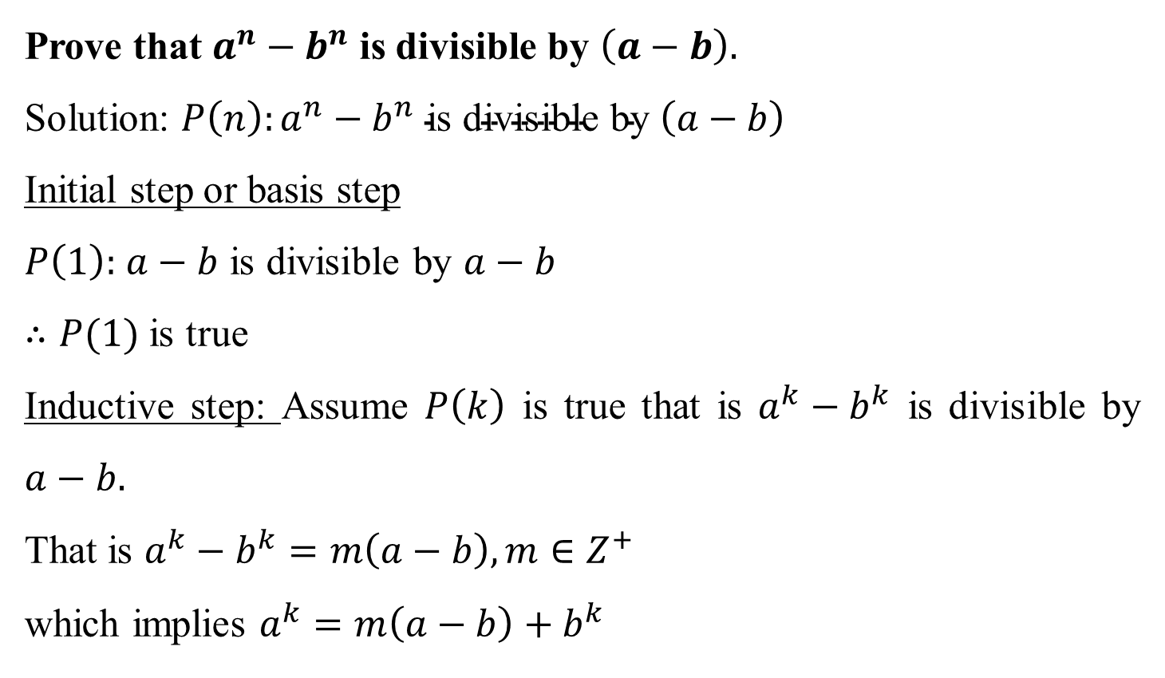
Mathematical Induction
Prove that $a^{n}−b^{n}$ is divisible by $\left(a−b\right).$
Solution: $P\left(n\right):a^{n}−b^{n} \text{is} \text{divisible} \text{by} \left(a−b\right)$
Initial step or basis step
$P\left(1\right):$ $a−b$ is divisible by $a−b$
$∴P(1)$ is true
Inductive step: Assume $P\left(k\right)$ is true that is $a^{k}−b^{k}$ is divisible by $a−b.$
That is $a^{k}−b^{k}=m\left(a−b\right), m∈Z^{+}$
which implies $a^{k}=m\left(a−b\right)+b^{k}$

Slide 45
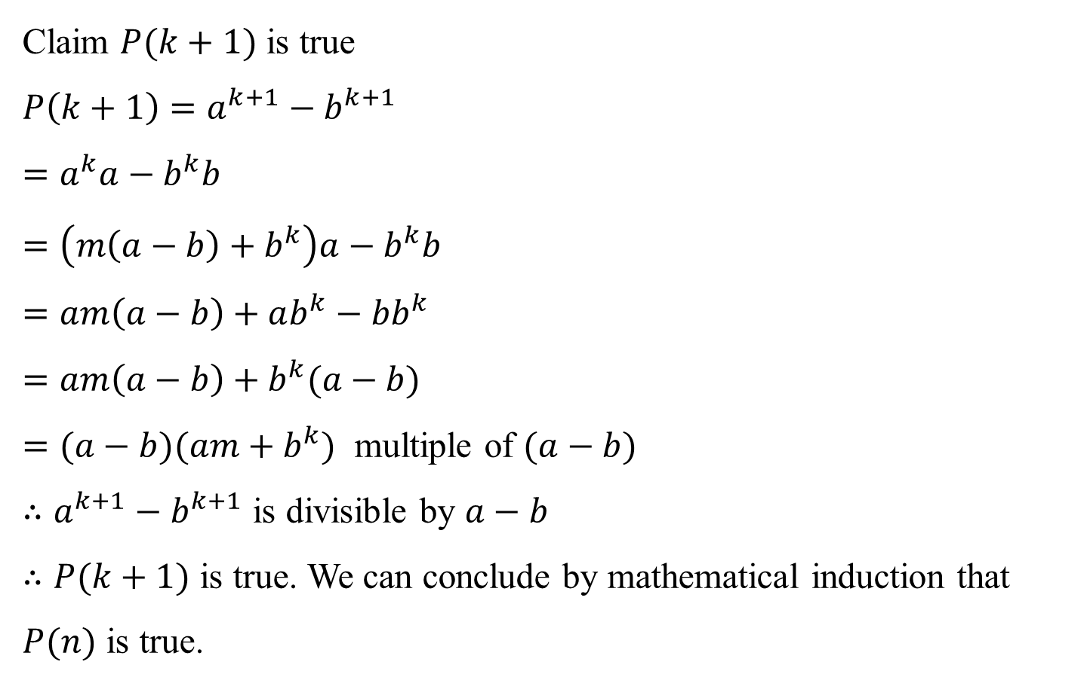
Mathematical Induction
Claim $P(k+1)$ is true
$$P\left(k+1\right)=a^{k+1}−b^{k+1}$$
$$=a^{k}a−b^{k}b$$
$$=\left(m\left(a−b\right)+b^{k}\right)a−b^{k}b$$
$$=am\left(a−b\right)+ab^{k}−bb^{k}$$
$$=am\left(a−b\right)+b^{k}(a−b)$$
$=(a−b)(am+b^{k})$ multiple of $(a−b)$
$∴a^{k+1}−b^{k+1}$ is divisible by $a−b$
$∴P(k+1)$ is true. We can conclude by mathematical induction that $P(n)$ is true.

Slide 46
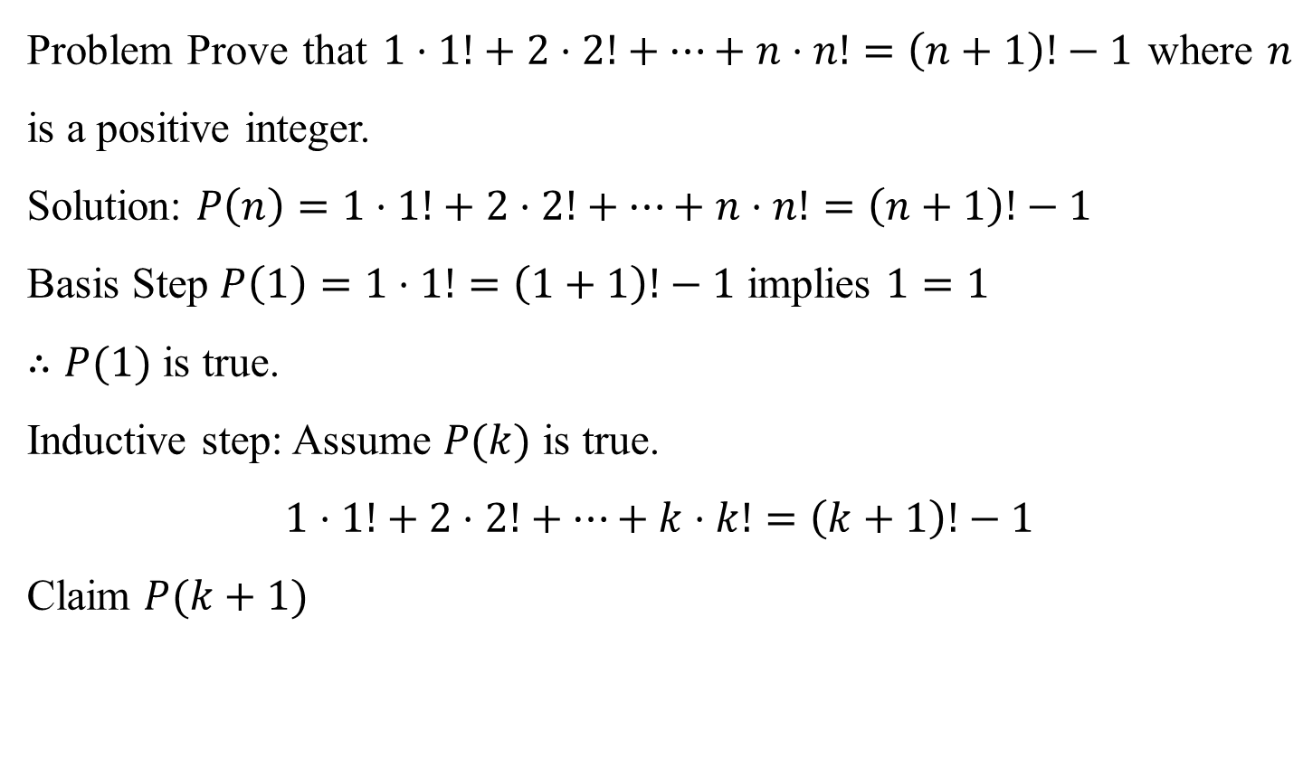
Mathematical Induction
Problem Prove that $1⋅1!+2⋅2!+…+n⋅n!=\left(n+1\right)!−1$ where $n$ is a positive integer.
Solution: $P\left(n\right)=1⋅1!+2⋅2!+…+n⋅n!=\left(n+1\right)!−1$
Basis Step $P\left(1\right)=1⋅1!=\left(1+1\right)!−1$ implies $1=1$
$∴P(1)$ is true.
Inductive step: Assume $P(k)$ is true.
$$1⋅1!+2⋅2!+…+k⋅k!=\left(k+1\right)!−1$$
Claim $P(k+1)$

Slide 47

Mathematical Induction
$$P\left(k+1\right)=1⋅1!+2⋅2!+…+k⋅k!+\left(k+1\right)⋅\left(k+1\right)!$$
$$=\left(k+1\right)!−1+\left(k+1\right)⋅\left(k+1\right)!$$
$$=\left(k+1\right)!\left[1+(k+1)\right]−1$$
$$=\left(k+1\right)!\left(k+2\right)−1$$
$$=\left(k+2\right)!−1$$
$∴P(k+1)$ is true. By induction method, $P(n)$ is true.

Slide 48
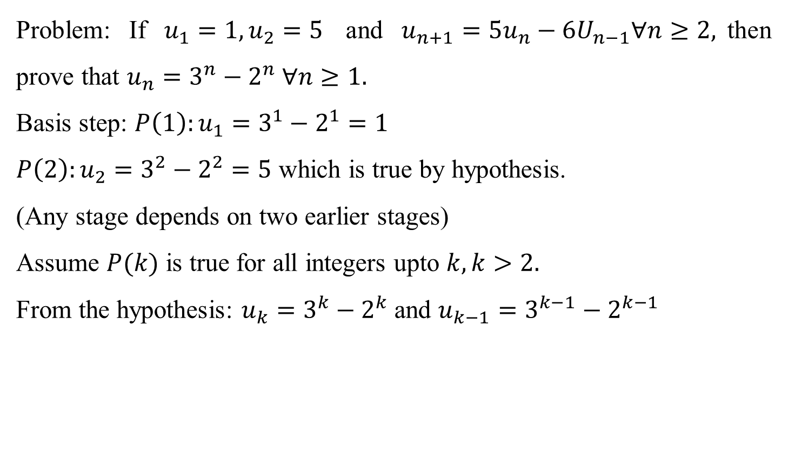
Strong Induction
Problem: If $u_{1}=1, u_{2}=5$ and $u_{n+1}=5u_{n}−6U_{n−1}∀n≥2,$then prove that $u_{n}=3^{n}−2^{n} ∀n≥1.$
Basis step: $P\left(1\right):u_{1}=3^{1}−2^{1}=1$
$P\left(2\right):u_{2}=3^{2}−2^{2}=5$ which is true by hypothesis.
(Any stage depends on two earlier stages)
Assume $P(k)$ is true for all integers upto $k, k>2.$
From the hypothesis: $u_{k}=3^{k}−2^{k}$and $u_{k−1}=3^{k−1}−2^{k−1}$

Slide 49

Strong Induction
$$u_{k+1}={5(3}^{k}−2^{k} )−6(3^{k−1}−2^{k−1})$$
$$=3⋅3^{k}−2⋅2^{k}$$
$$=3^{k+1}−2^{k+1}$$

